Slide 1




Week 3
Keep It Going!
This week we will focus on these skills!
Notes:
Teacher Notes
Week 3:
This PowerPoint presentation provides…
A reminder of the tasks the students will need to think about and complete that week, together with a list of resources that will help them.
An activity that is linked to the tasks for that week to help them to succeed.
Note: Depending on how much time you have in advance of the challenge you may want to do some of the introductory activities earlier.

Slide 2
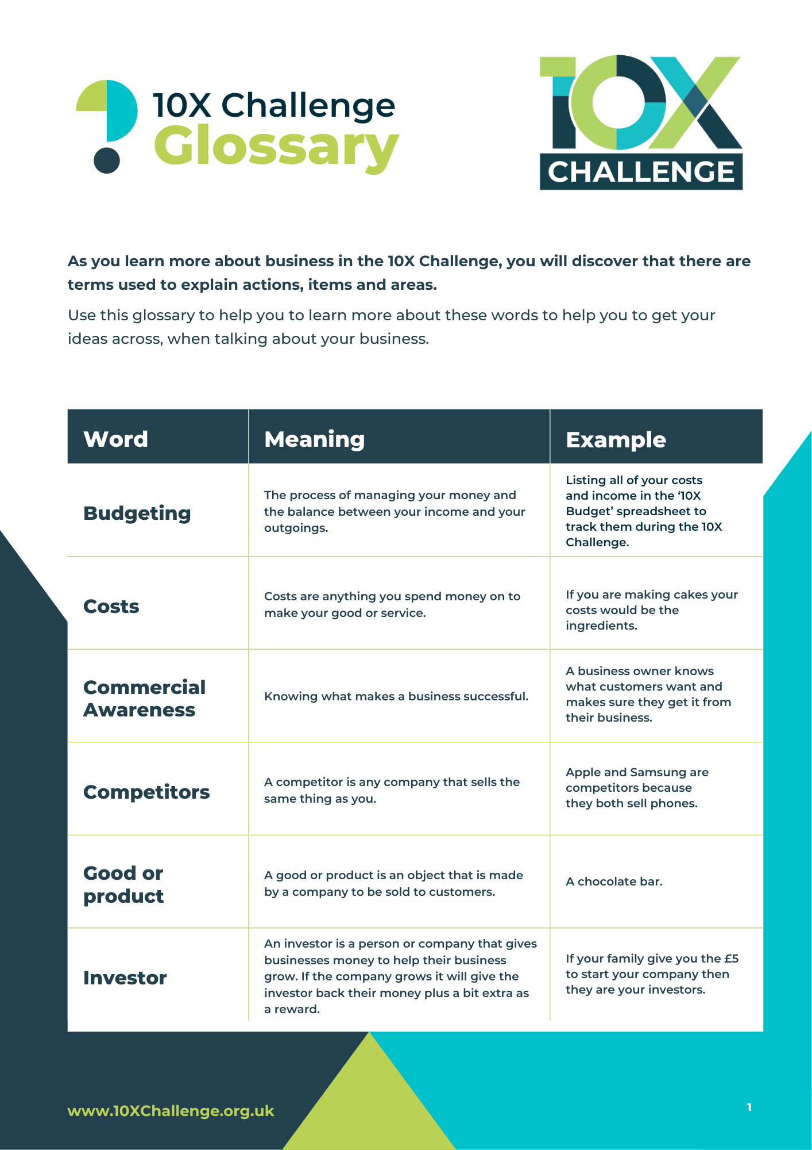
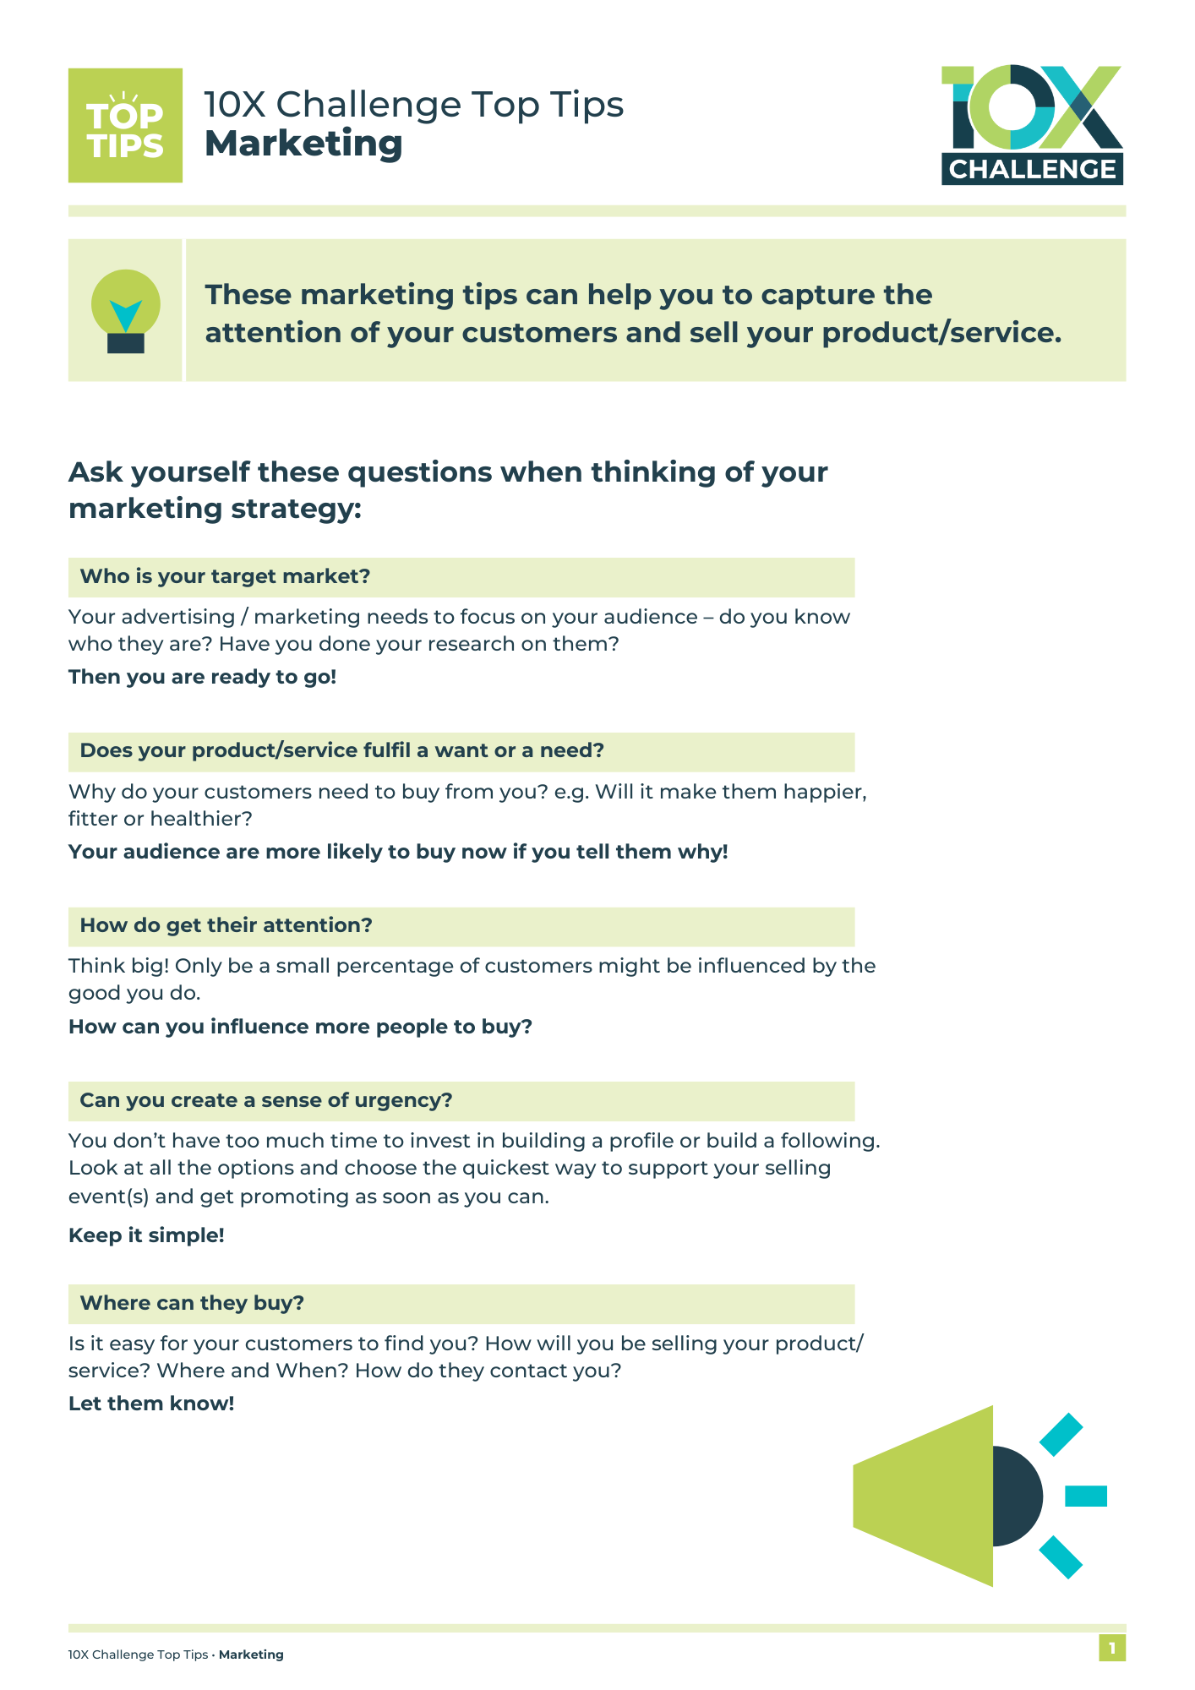
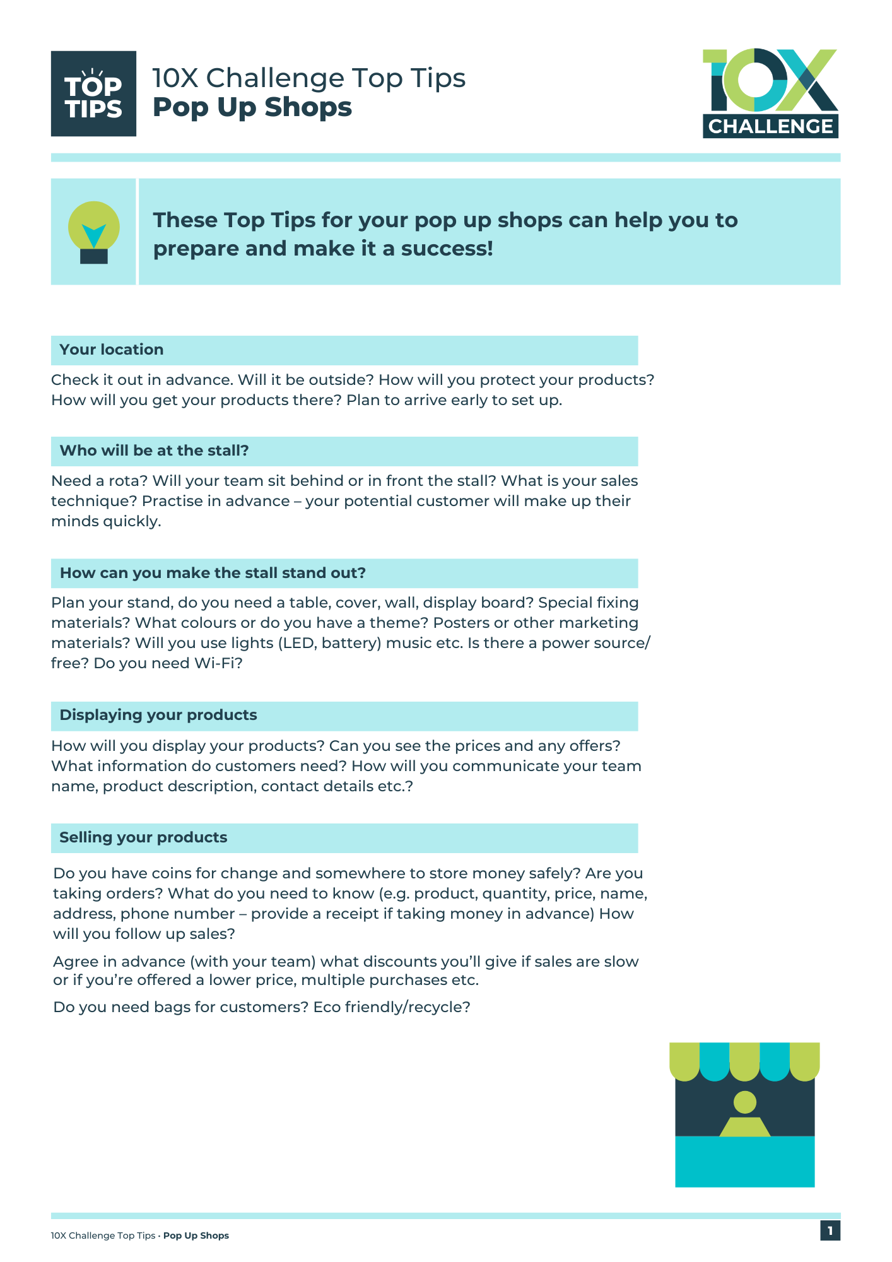

Keep It Going!
You will need:
10X Challenge Workbook
10X Challenge Glossary
Top Tips for Marketing
Top Tips for Pop-Up Shops
Notes:
Teacher Notes
This slide maps out what resources are available to students during Week 3.

Slide 3


Keep It Going!
What you need to do:
Get your product or service ready to sell.
Keep track of your spending.
Decide on your advertising.
Promote your selling event.
Check you are ready to go.
Enter the Sales Poster Competition!
Think: How can unhelpful conflicts be avoided? What are some of the different ways to acquire information?
How would you rank yourself?
Notes:
Teacher Notes
Following the available resources for Week 3, this slide maps out what specifically pupils will need to do during Week 3.
Skills Builder Essential Skills
Teamwork - Step 9: I speak engagingly by using tone, expression and gesture to engage listeners
To incorporate the essential skill, ask the following reflective question when covering this slide:
How can unhelpful conflicts be avoided?
Problem Solving - Step 7: I explore complex problems by building my understanding through research
Problem solving is the ability to find a solution to a situation or challenge. Talk to students about what else may be helpful to know when deciding how best to keep track of their spending, or making decisions on advertising and preparing their products and services for sale. Get them to think about where they might find that information.
To incorporate the essential skill, ask the following reflective question when covering this slide:
What are some of the different ways to acquire information?
After students have considered this, offer the following statement and prompt them to rank themselves based on the Likert scale below (click to show this on the slides):
I am effective at resolving conflicts with my team.
I am able to make difficult decisions by informing myself through research.
Likert Scale:
Almost never
Rarely
Sometimes
Often
Almost always

Slide 4
Keep It Going!
Think: How can unhelpful conflicts be avoided? What are some of the different ways to acquire information?
How would you rank yourself?
What you need to do:
Get your product or service ready to sell.
Keep track of your spending.
Decide on your advertising.
Promote your selling event.
Check you are ready to go.
Enter the Sales Poster Competition!
I am effective at resolving conflicts with my team.
I am able to make difficult decisions by informing myself through research.
1. Almost never
2. Rarely
3. Sometimes
4. Often
5. Almost always
Notes:
Teacher Notes
After students have considered this, offer the following statement and prompt them to rank themselves based on the Likert scale below:
I am effective at resolving conflicts with my team.
I am able to make difficult decisions by informing myself through research.
Likert Scale:
Almost never
Rarely
Sometimes
Often
Almost always

Slide 5


Ready to Sell?
This week you will be focusing on getting your product or service ready to sell at your pop-up shops!
During this time, you’ll figure out what each team members strengths are and how to work as a team to create a successful product or service.
Think: How can you effectively encourage others to contribute? How do goals and success criteria fit together?
How would you rank yourself?
Notes:
Teacher Notes
For Week 3, pupils should be ready to sell their product or service and will get to grips with the finances of running their own 10X business.
Remind them that they will be using their teamwork skills as they work collaboratively to successfully create their products or set up their service.
Skills Builder Essential Skills
Teamwork - Step 8: I contribute to group decision making, encouraging others to contribute
Teamwork is the skill of working cooperatively with others towards achieving a shared goal. Explain that across the challenge students will need to support each other and discuss what this might look like and why it is important. Students could identify situations for this week’s task where they think they will need to support others.
To incorporate the essential skill, ask the following reflective question when covering this slide:
How can you effectively encourage others to contribute?
Aiming High - Step 8: I set goals and secure the right resources to achieve them
Aiming High is the ability to set clear, tangible goals and devise a robust route to achieving them. Explain to students that they will undoubtedly encounter challenges across the project but that it’s important to have a positive attitude to new challenges. Students could talk about why they think it is necessary to do this.
To incorporate the essential skill, ask the following reflective question when covering this slide:
How do goals and success criteria fit together?
After students have considered this, offer the following statement and prompt them to rank themselves based on the Likert scale below (click to show this on the slides):
I am able to effectively encouraging others to contribute.
I am able to apply my understanding of how goals and success criteria fit together.
Likert Scale:
Almost never
Rarely
Sometimes
Often
Almost always

Slide 6
Ready to Sell?
Think: How can you effectively encourage others to contribute? How do goals and success criteria fit together?
How would you rank yourself?
This week you will be focusing on getting your product or service ready to sell at your pop-up shops!
During this time, you’ll figure out what each team members strengths are and how to work as a team to create a successful product or service.
I am able to effectively encouraging others to contribute.
I am able to apply my understanding of how goals and success criteria fit together.
1. Almost never
2. Rarely
3. Sometimes
4. Often
5. Almost always
Notes:
Teacher Notes
After students have considered this, offer the following statement and prompt them to rank themselves based on the Likert scale below:
I am able to effectively encouraging others to contribute.
I am able to apply my understanding of how goals and success criteria fit together.
Likert Scale:
Almost never
Rarely
Sometimes
Often
Almost always

Slide 7


Advertising
How can you promote your product or service?
Social media, posters or word of mouth?
Pop-Up Shop or join an event?
Sell at a local market?
Contact your local community?
Local radio or press?
Use your Top Tips for Advertising guide to help you gain engagement at your pop-up shop, or if you’re selling to your friends or family!
Discuss: How can we create solutions to problems, and where might we look for inspiration?
How would you rank yourself?
Notes:
Teacher Notes
Advertising will be key to success, so this slide focuses pupils’ attention on this aspect of their planning during Week 3.
Activity (10-15 minutes)
Ask teams or individuals to discuss how they can promote their product or service (5 minutes) and to share with the class (5-10 minutes)
They can use their 10X Challenge Workbook and Top Tips for Advertising to help them.
Skills Builder Essential Skills
Problem Solving - Step 9: I create solutions for complex problems by generating a range of options
Problem solving is the ability to find a solution to a situation or challenge. Talk to students about further information they might need to find out when thinking about their branding. Do they need further examples? Do they want to look at what similar products or services have done? Get them to think about where they might find that information.
To incorporate the essential skill, ask the following reflective question when covering this slide:
How can we come up with solutions to problems, and where might we look for inspiration?
After students have discussed this, offer the following statement and prompt them to rank themselves based on the Likert scale below (click to show this on the slides):
I am able to create solutions for complex problems by generating a range of options.
Likert Scale:
Strongly disagree
Disagree
3. Neither agree nor disagree
4. Agree
5. Strongly agree
6. Don't know

Slide 8
Advertising
Discuss: How can we create solutions to problems, and where might we look for inspiration?
How would you rank yourself?
How can you promote your product or service?
Social media, posters or word of mouth?
Pop-Up Shop or join an event?
Sell at a local market?
Contact your local community?
Local radio or press?
Use your Top Tips for Advertising guide to help you gain engagement at your pop-up shop, or if you’re selling to your friends or family!
I am able to create solutions for complex problems by generating a range of options.
1. Almost never
2. Rarely
3. Sometimes
4. Often
5. Almost always
Notes:
Teacher Notes
After students have discussed this, offer the following statement and prompt them to rank themselves based on the Likert scale below:
I am able to create solutions for complex problems by generating a range of options.
Likert Scale:
Almost never
Rarely
Sometimes
Often
Almost always

Slide 9
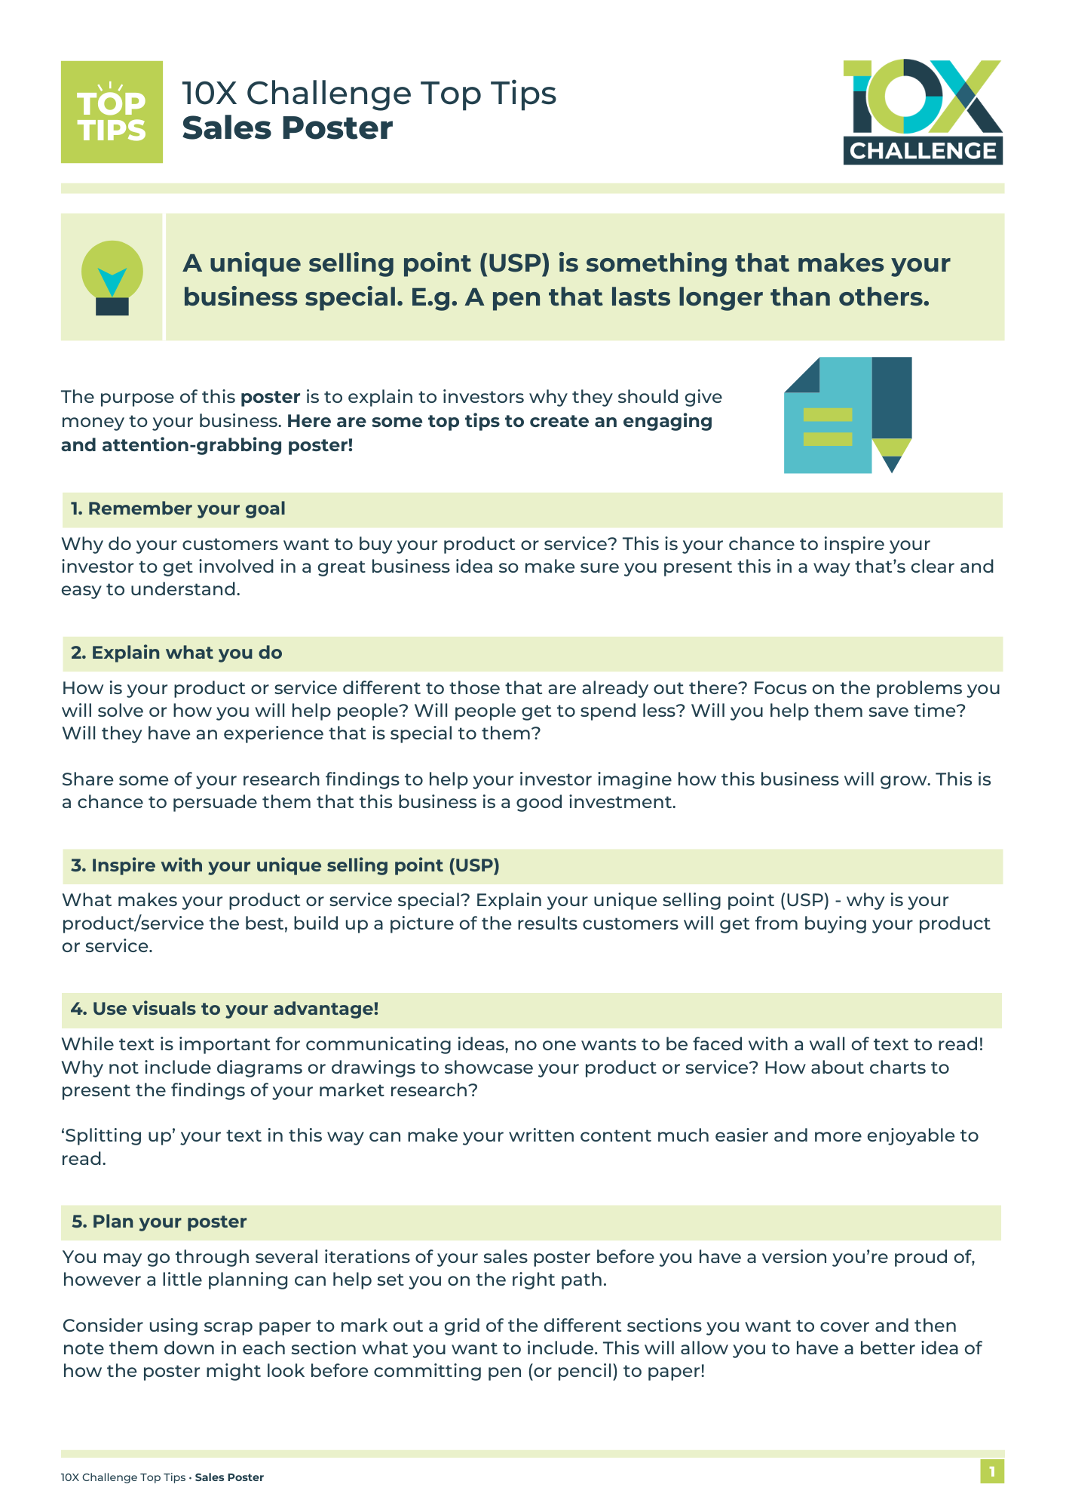

Submit Your Sales Poster!
Don’t forget to submit your poster!
Your poster should be no more than one side of page and should showcase your product or service, its cost, your market research findings, and what makes you business unique!
Refer to your Top Tips for Sales Posters guide if you need to.
Discuss: What sort of questions are likely to help to improve your ideas?
How would you rank yourself?
Notes:
Teacher Notes
Remind the pupils that they can enter the Sales Poster Competition. The deadline for submission is midnight on the Sunday at the end of Week 3 (check the 10X website for the exact date).
Skills Builder Essential Skills
Creativity - Step 9: I develop ideas by asking myself questions
Creativity the use of imagination and the generation of new ideas. To help us to generate ideas we are sometimes provided with a brief. A brief is a problem or challenge that we have to come up with ideas to solve. The brief might be short or long; it might be in a written form, or it might be spoken.
To incorporate the essential skill, ask the following reflective question when covering this slide:
What sort of questions are likely to help to improve your ideas?
After students have discussed this, offer the following statement and prompt them to rank themselves based on the Likert scale below (click to show this on the slides):
I am able to develop ideas through asking questions.
Likert Scale:
Strongly disagree
Disagree
3. Neither agree nor disagree
4. Agree
5. Strongly agree
6. Don't know
7. Not applicable

Slide 10
Submit Your Sales Poster!
Discuss: What sort of questions are likely to help to improve your ideas?
How would you rank yourself?
Don’t forget to submit your poster!
Your poster should be no more than one side of page and should showcase your product or service, its cost, your market research findings, and what makes you business unique!
Refer to your Top Tips for Sales Posters guide if you need to.
I am able to develop ideas through asking questions.
1. Almost never
2. Rarely
3. Sometimes
4. Often
5. Almost always
Notes:
Teacher Notes
After students have discussed this, offer the following statement and prompt them to rank themselves based on the Likert scale below:
I am able to develop ideas through asking questions.
Likert Scale:
Almost never
Rarely
Sometimes
Often
Almost always

Slide 11
Week 3 Recap
You have begun to keep track of your spending.
You have decided on your advertising.
You have started to promote your selling event.
You have finished your product or service, ready to sell!
You have entered the Sales Poster Competition!
You have developed your essential skills.
Notes:
Teacher Notes
This slide reminds students of what they have achieved at the end of Week 3!

Slide 12

COMPLETE
Well done, you have completed Week 3!

